Slide 1
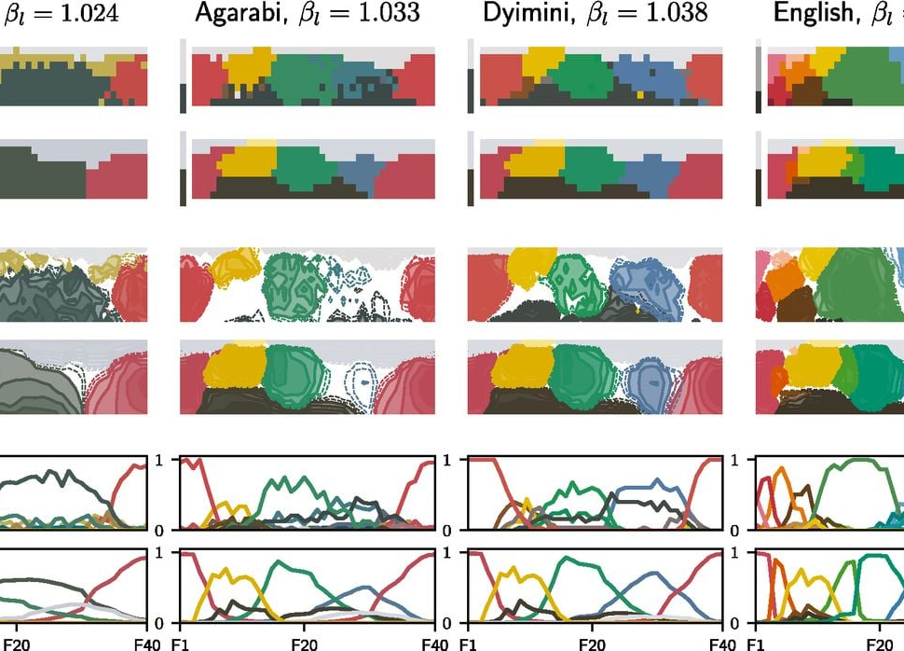
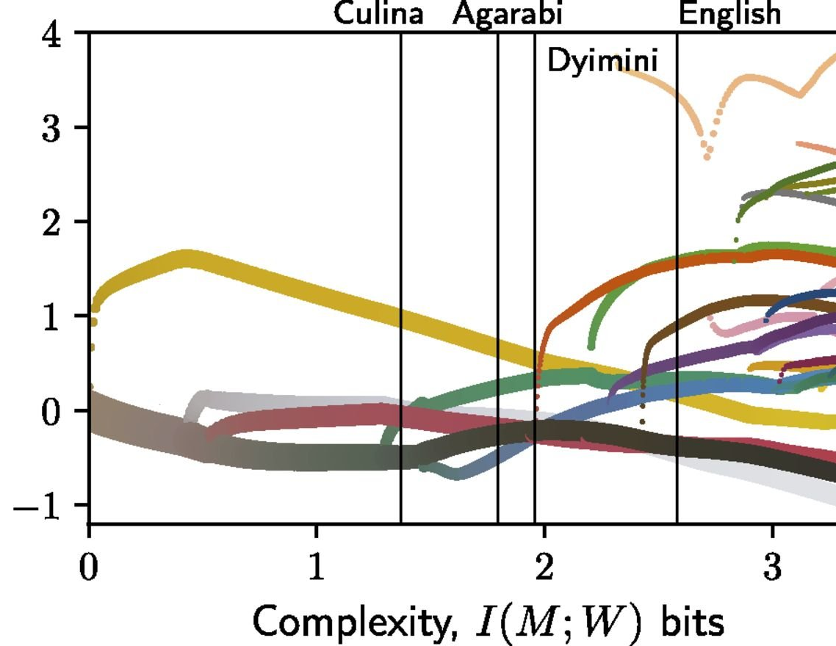
The Puzzle of Color Naming
Yehonatan Ezra, Nitzan Ventura, Gal Cesana

Slide 2
Introduction
Our project is based on the article "Efficient Compression in Color Naming and Its Evolution" by Noga Zaslavsky, Charles Kemp, Terry Regier, and Naftali Tishby, published in PNAS in July 2018.
The Main Question: Why do different languages divide up the color spectrum in different ways? And despite these differences, why are there strong universal patterns?
The Article’s Main Idea: Languages are not random. They have evolved to be highly efficient systems for communication.
Color naming represents an optimal balance, or trade-off, between two competing needs:
Simplicity (Low Complexity): Having a small, easy-to-learn set of color terms.
Informativeness (High Accuracy): Being able to describe a specific color precisely.
The authors propose that color naming systems across the globe are near-perfect solutions to this trade-off problem.

Slide 3
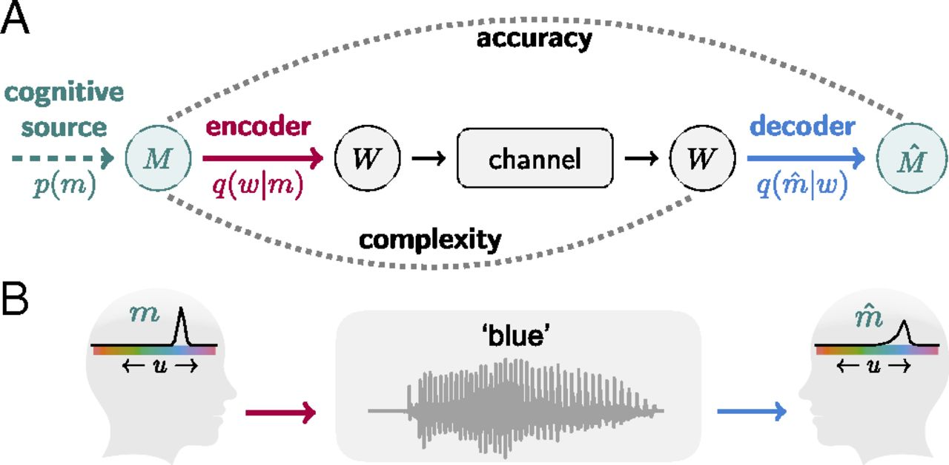
The "Information Bottleneck" Framework
The authors formalize this idea of a trade-off using a concept from information theory called the Information Bottleneck (IB).
Communication as a Game of Compression:
A speaker (encoder) wants to communicate a specific color (meaning) by choosing a word.
A listener (decoder) hears the word and needs reconstruct the intended meaning.

Slide 4
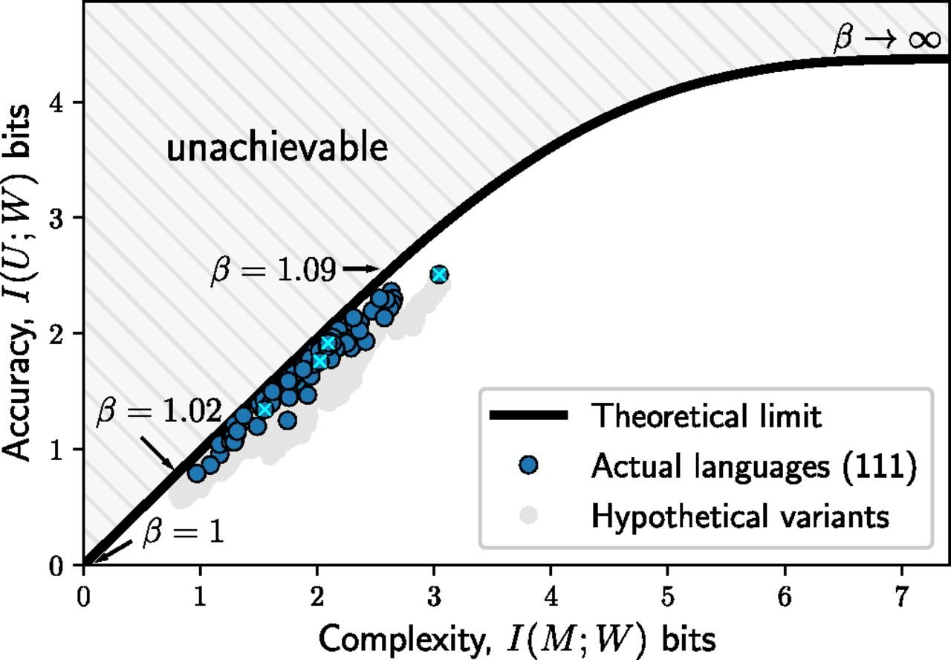


The "Information Bottleneck" Framework
The Trade-Off:
Complexity: Measured as the mutual information between meanings and words $I(M;W)$. This is the "cost" of the vocabulary. A simple system (e.g., only "light" and "dark") has low complexity.
Accuracy: Measured as the mutual information between words and the color universe $I\left(W;U\right)$. This is the "benefit." A super precise system will have high accuracy.
The IB curve (black line) represents the theoretical limit of how accurate a system can be for a given level of complexity. You can't do better than the curve.

Slide 5
Article Result #1 Languages Are Near-Optimally Efficient
The most striking finding is that real-world languages are not just efficient—they are nearly perfect.
The Test: The researchers took color naming data from the World Color Survey (111 languages) and plotted each language's complexity vs. accuracy on the Information Bottleneck graph.
The Result: The languages (blue dots) fall almost perfectly along the theoretical boundary of optimal efficiency (the black IB curve).
What this means:
Languages from different families and regions have independently evolved to arrive at an optimal solution for communicating color.
The vast variation we see in color naming systems isn't random, but rather different optimal solutions to the same fundamental problem. For example, some languages prioritize simplicity, while others prioritize accuracy, but they all remain on the efficiency frontier.

Slide 6

Article Result #2 A Unified Theory of Color Term Evolution
The IB model doesn't just describe a static picture; it provides a single, unified process for how color systems evolve.
Evolution along the Curve: By changing a single "trade-off" parameter ($β$) in the model, the researchers can simulate the evolution of a color system, moving from simple to complex along the IB curve.
Unifying Competing Theories: This simulated evolution elegantly combines two major theories of color naming:
Discrete Stages (Berlin & Kay): The model shows "phase transitions" where new, stable color categories (like black/white, then red, then green/yellow, then blue) emerge in an order that closely matches the classic proposed evolutionary sequence.
Continuous Evolution: Between these stages, the model shows that categories emerge gradually and that boundaries are "soft," leading to inconsistent naming in some regions of color space—something that is observed empirically but that older models struggled to explain.
In essence, the drive for efficiency provides a single mechanism that explains both the discrete stages and the continuous, messy transitions of how languages build their color vocabularies.

Slide 7
Our research question
How do specific structural and typological characteristics of languages (e.g., number of basic color terms, focal color distributions, semantic domain granularity) influence their communicative fitness under the Information Bottleneck framework?
Sub-questions:
Random color space vs k-means color space vs Human made color space.
How does the lexicon size affects the fitness of the language?
How languages adapt to different environments?

Slide 8
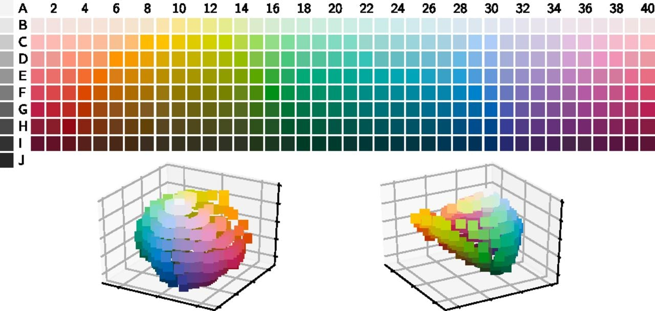
Methodology – Data Source
The World Color Survey (WCS) palette that we use consists of 330 “chips” selected from the Munsell color system. To analyze these in a perceptually uniform way, we convert every Munsell chip into CIELAB coordinates (L*, a*, b*):
L* (lightness) runs from near-black (≈ 2) up to almost white (≈ 98), matching our original Munsell value rows.
a* (green–red axis) and b* (blue–yellow axis) encode hue and chroma in a way that roughly corresponds to Munsell hue and saturation—but note that the WCS chips sit at different maximal chroma for different hue/lightness combinations, so their a*/b* coordinates form an irregular cloud in 3D space.
By working in CIELAB space, we ensure that “distance” between any two chips corresponds approximately to human perceptual difference, which is crucial when quantifying naming accuracy (via KL divergence) and modeling compression (via information-rate) under the Information Bottleneck framework.

Slide 9

Methodology – Language Evolution Simulation
How it works:
The World of Color: We start by creating an Environment that represents a "meaning space" of 330 different colors, defined by their CIELAB coordinates. We can even simulate different visual environments, like a "forest" with more greens or a "beach" with more blues, by changing the frequency of certain colors.
A Population of Languages: We then initialize a population of competing "languages". Each Language is essentially a system for mapping meanings (colors) to words.
These languages can have different lexicon sizes (number of words).
They can also use different strategies to create their vocabulary, from completely random mappings to more structured systems based on clustering similar colors together (KMeans).
Survival of the Fittest: The core of our project is the evolutionary simulation itself. Over many generations, we assess each language's "fitness". A language is considered "fit" if it achieves a good balance between the accuracy and complexity according to a given $β$ tradeoff parameter.
Fitness = (beta * Accuracy) – Complexity

Slide 10
Methodology – Language Evolution Simulation
Evolutionary Dynamics:
In each generation, the proportion of each language in the population changes.
Languages with higher fitness scores become more common, while less fit languages die out. This process is modeled using the replicator equation.
What We Study:
By the end of the simulation, we can see which types of languages become dominant.
We run experiments to compare the efficiency of different language strategies and see how they adapt to different environments.
We compare our simulated results to real human language data to see if our model of efficiency can explain the patterns we see in human color vocabularies.

Slide 11
The Results

Slide 12
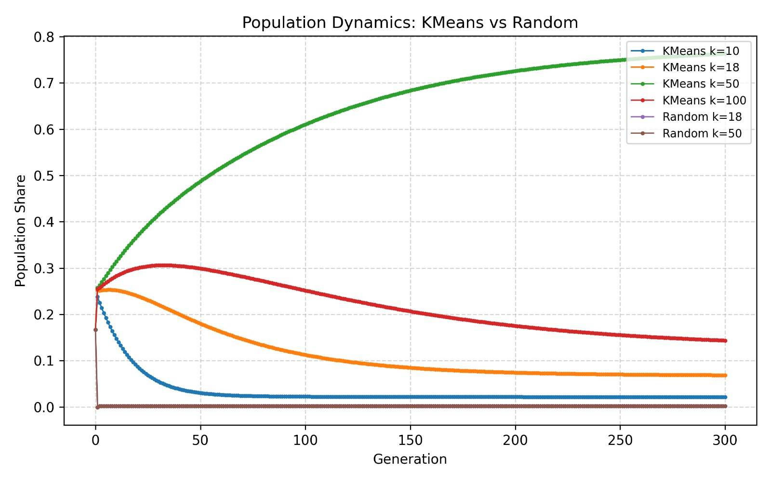
Competing strategies over different lexicon sizes
Results
Evolution Simulation
The graph shows the evolutionary dynamics of different encoding strategies over 300 generations.
The simulation demonstrates that structured encoders like KMeans can evolve successfully — but only when they balance detail with simplicity. Overly simple or overly complex strategies fail to survive, while randomly organized mappings never gain traction.

Slide 13
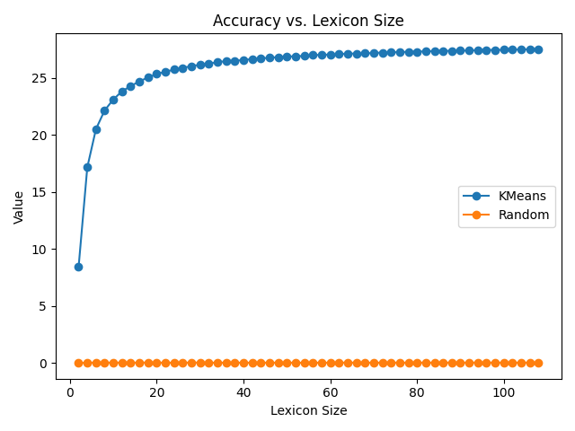
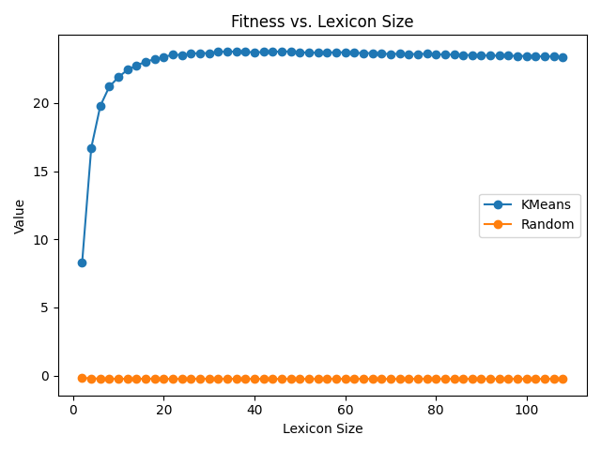
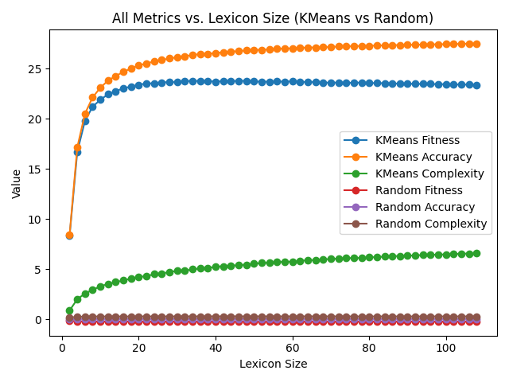
Competing strategies over different lexicon sizes
Results
Fitness Comparison
A structured language (like KMeans) that groups similar meanings together can convey a large amount of information with even a small vocabulary.
An unstructured, random system is information-theoretically useless for communication, as it offers no improvement over random guessing.
The principle of diminishing returns is clearly visible; there is a "sweet spot" for lexicon size where a language is highly efficient without being overly complex.

Slide 14

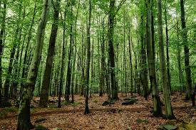

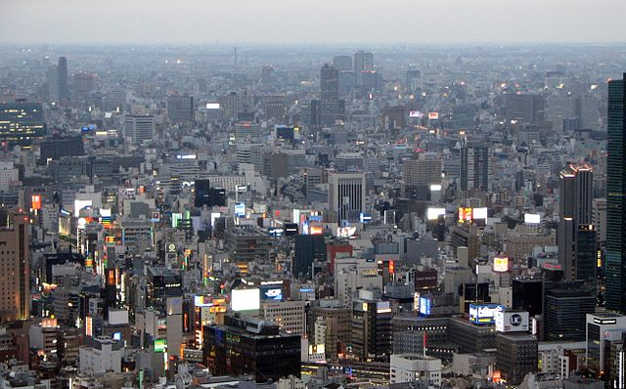
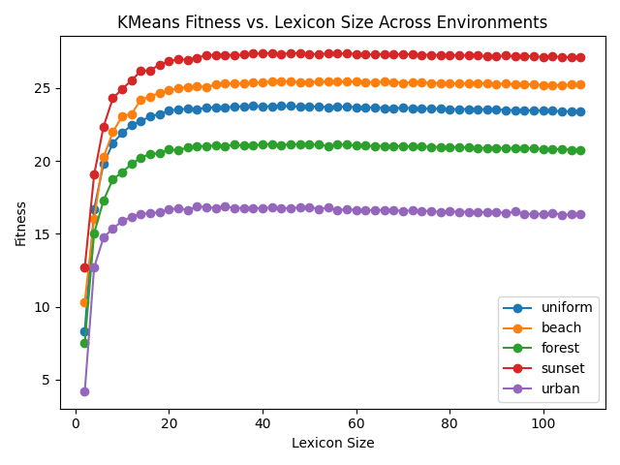
Different Environments
Up to now, we’ve assumed a uniform distribution of colors in the world. However, real-world contexts exhibit diverse color statistic. To analyze how different environment influence the evolution of language, we built a 4 reprehensive environment – each defined by its own characteristic distribution over CIELAB colors:
Beach – boost high b* values to capture the bright blues of sky ad water and sandy yellows.
Forest - boost low a* values to emphasize the deep greens of foliage.
Sunset – Boost high a* or b* to mimic the warm, rad, oranges, and gold of dusk.
Urban – boost low chroma ((√((a*)²+(b*)²)) neutrals represent muted, grey-toned cityscapes.
As shown here, identical KMeans‐based languages achieve markedly different peak fitnesses depending on the environmental color statistics

Slide 15
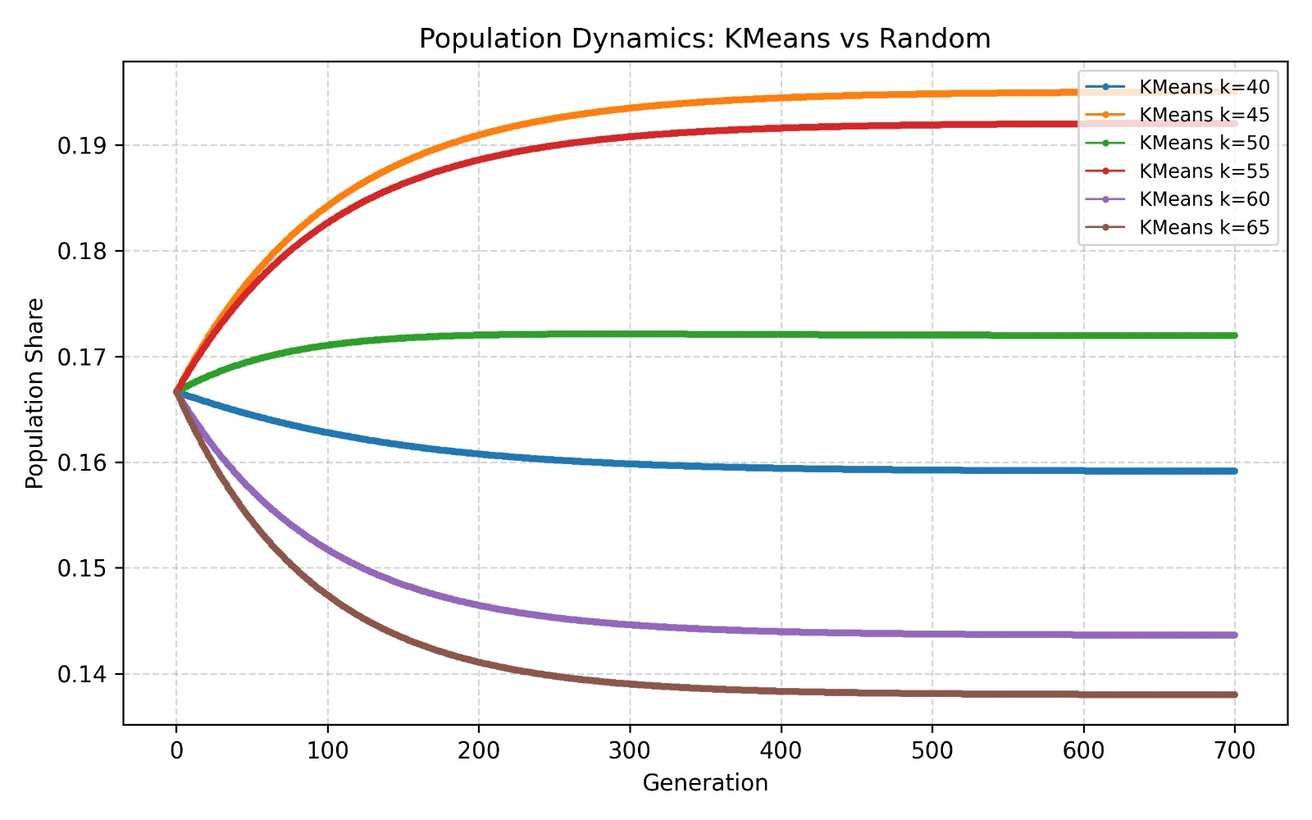
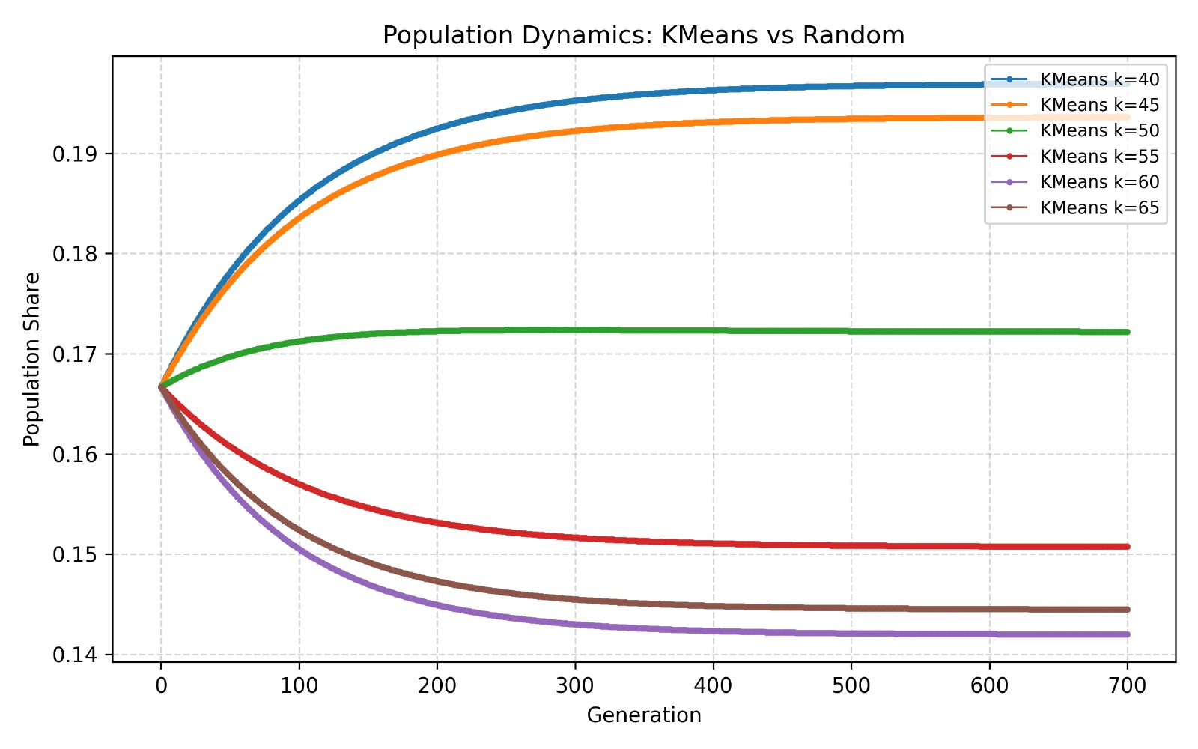
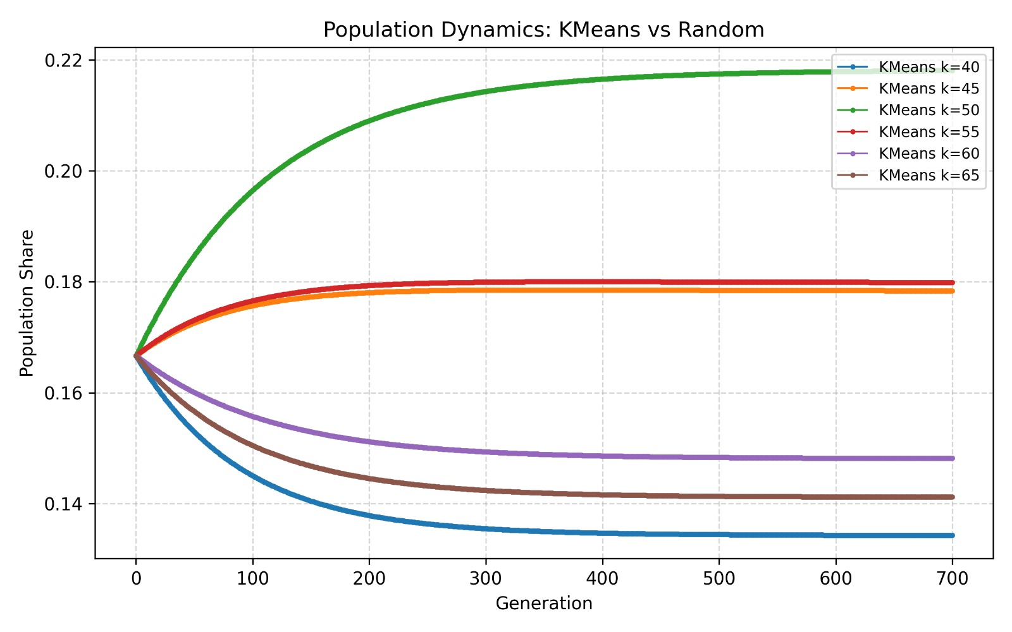
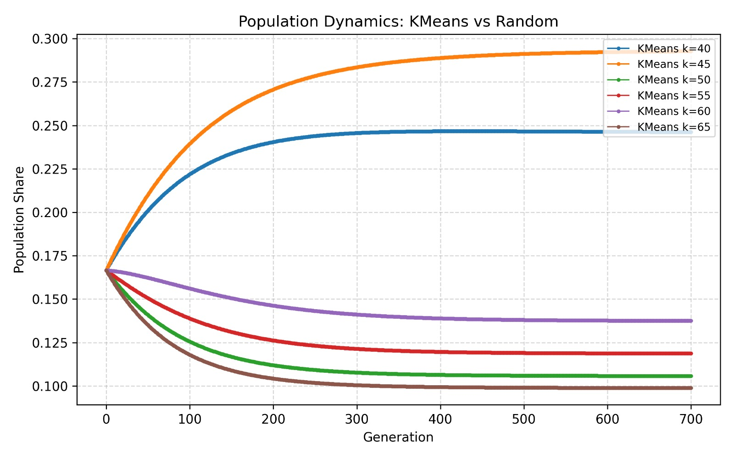
Different Environments
Results
Evolution Simulation
‘Sunset’
‘Beach’
‘Urban’
‘Forest’

Slide 16
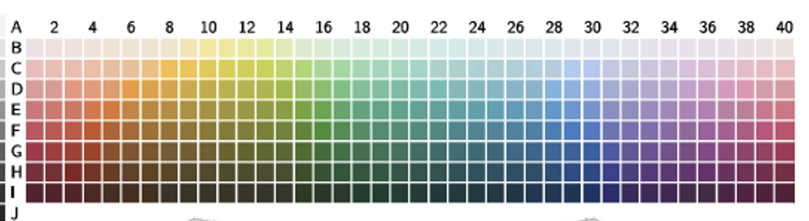
Behavior of Real Languages in Color Naming
To ground our simulations in real language use, we ran a large-scale human color-naming survey. Fifty native speakers each labeled 330 color patches-sampled uniformly from CIELAB space-using a fixed vocabulary of 18 terms:
• “dark”/“light” for each of {orange, yellow, green, blue, purple, pink, brown, gray} • “black” and “white”
From the pooled data we derive, for each patch, an empirical distribution p(label|color), which we then collapse into three benchmark lexicons:
Full - 18 labels.
Merge each light/dark pair into one base color – 10 labels.
Light vs dark (white → light, black → dark) – 2 labels.
To further refine these human benchmarks, we’re still collecting data - if you’d like to help improve our color‐naming model, please participate in our ongoing survey!
For more info contact us at our site

Slide 17
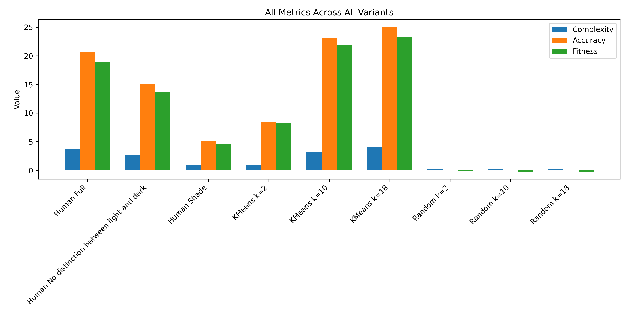
Examine Human made language
Results
Fitness Comparison
Better clustering (higher k in K-Means) can beat the human lexicon in the IB‐fitness trade-off, whereas random mappings fail to capture any useful signal.

Slide 18
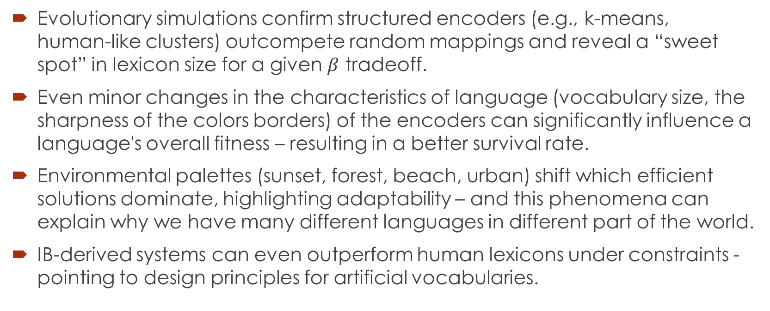
Conclusions
Evolutionary simulations confirm structured encoders (e.g., k‑means, human‑like clusters) outcompete random mappings and reveal a “sweet spot” in lexicon size for a given $β$ tradeoff.
Even minor changes in the characteristics of language (vocabulary size, the sharpness of the colors borders) of the encoders can significantly influence a language's overall fitness – resulting in a better survival rate.
Environmental palettes (sunset, forest, beach, urban) shift which efficient solutions dominate, highlighting adaptability – and this phenomena can explain why we have many different languages in different part of the world.
IB‑derived systems can even outperform human lexicons under constraints - pointing to design principles for artificial vocabularies.

Slide 19
Future Work
Finding optimal strategies for IB fitness - which strategies outperform k-means in our simulation?
Experiment more to find possible interesting correlations. For example: best beta values per environment, best lexicon size per beta value etc. (To explain if different languages evolved with different betas because of their environmental differences for example)
Non-noiseless channel, introducing randomness and noise to explore robustness of languages
Evolving lexicon size – allowing languages to insert new words or remove existing words from lexicon over time
“Mutation” – allow languages to influence each other, adopting of terms from high-fitness languages

Slide 20
Questions ?

